Slide 1
Analysis on clones using metrics and their behavioural patterns
Data science and big data analytics
Group 7:
Ankhi Bhanja Choudhury
Chuong Tach Nguyen
Disha Purohit
Ashwini Shanmuganandhavadivel

Slide 2
Clone Detection and Aspect Mining
Clone - repeated code usage pattern
Aspect - programming abstraction for “cross-cutting” concerns
Refactoring – syntactic edits without any change in semantics/code logic
Clone detection yields candidates for refactoring
Clone class metrics – measures pertaining to a group/class of clones

Slide 3
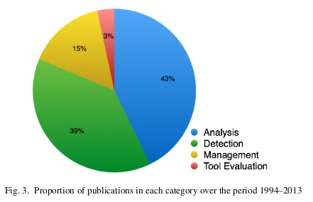
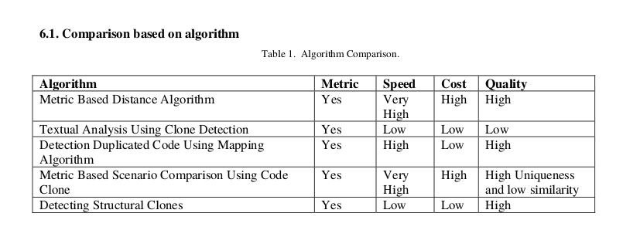
Motivation
31/01/2017
Analysis on clones using metrics and their behavioral patterns

Slide 4
smartshark$clone_instance
Database collection with one clone per document/entry/row
Each clone_instance document belongs to a clone_class
A clone_class brings together all related clone_instances to be refactored
Each clone_class has metrics associated to it
Clone Class Metric | Description | Calculated from
CA | Clone Age | No of revisions since creation
CI | Clone Instances | Multiplicity of clone_class
CCO | Clone Complexity | McGabe complexity
CE | Clone Embeddedness | In + Out references to subroutines
CLLOC | Clone Lines of Code
CV | Clone Variability | Number of changes/CA
NCR | Normalized Clone Radius | Average distance between clones
31/01/2017
Analysis on clones using metrics and their behavioral patterns
Notes:
McGabe Complexity

Slide 5
smartshark$clone_instance$clone_class
Clone Class Metric | Description | Calculated from
CA | Clone Age | No of revisions since creation
CI | Clone Instances | Multiplicity of clone_class
CCO | Clone Complexity | McGabe complexity
CE | Clone Embeddedness | In + Out references to subroutines
CLLOC | Clone Length in Lines of code
CV | Clone Variability | Number of changes/CA
NCR | Normalized Clone Radius | Average distance between clones
CR | Clone Risk | CLLOC*CI*CCO*NCR*CV
CEE | Clone Elimination Effort | CI*CE*NCR
CEG | Clone Elimination Gain | CR/CEE
31/01/2017
Analysis on clones using metrics and their behavioral patterns

Slide 6
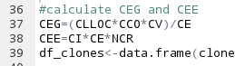
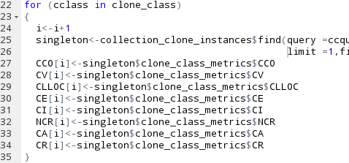
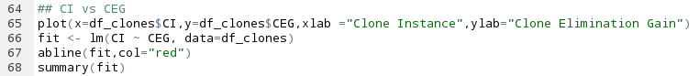
Steps Involved
Identify the distinct clone classes
For each clone class, extract the corresponding metrics
Fit CEG and CEE to linear models with CI and CLLOC as input respectively
Plot bar chart with CEG and CEE against top 50 clone classes
31/01/2017
Analysis on clones using metrics and their behavioral patterns

Slide 7
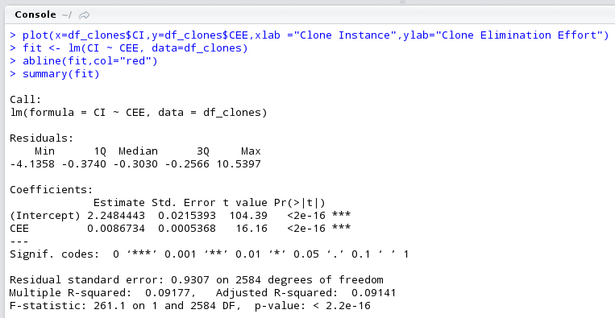
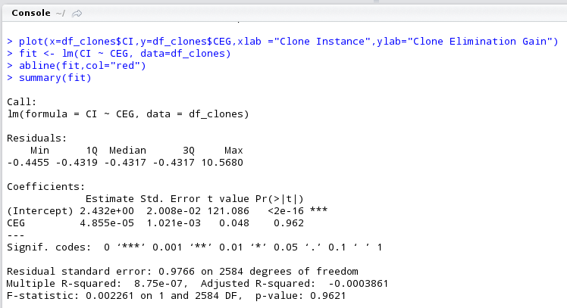
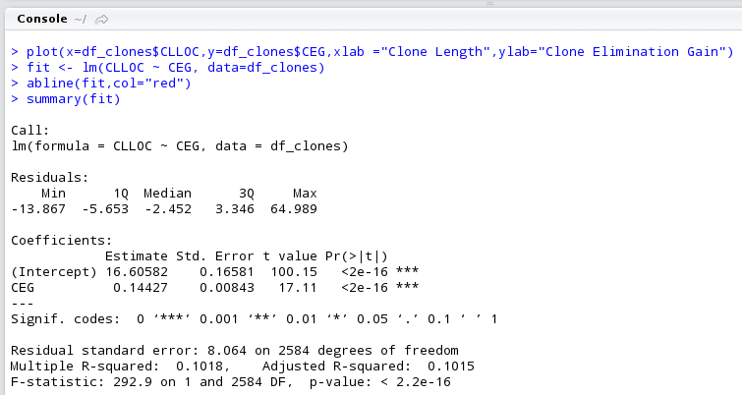
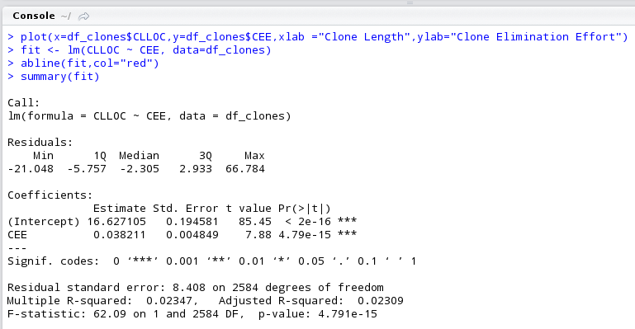
Linear Fit
CI vs CEE
Linear Fit
CI vs CEG
Linear Fit
CLLOC vs CEG
Linear Fit
CLLOC vs CEE

Slide 8
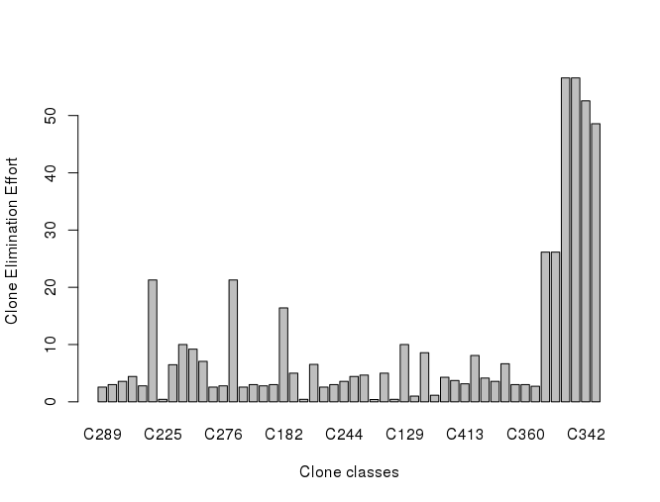
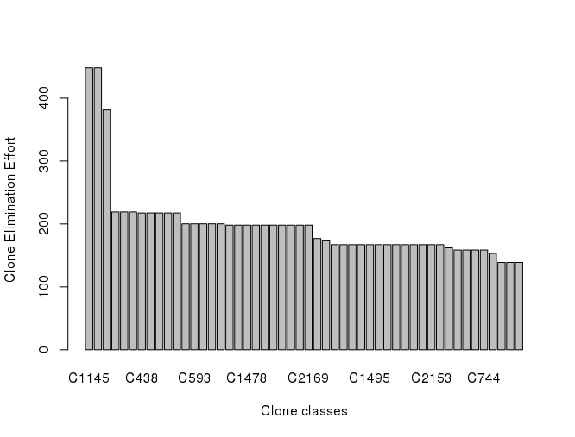
Bar plot : Clone_class vs CEE
unsorted
sorted by CEE, top 50

Slide 9
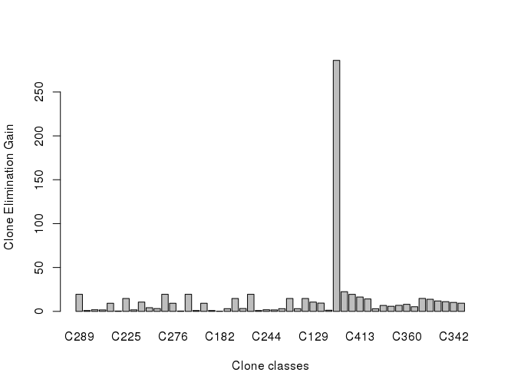
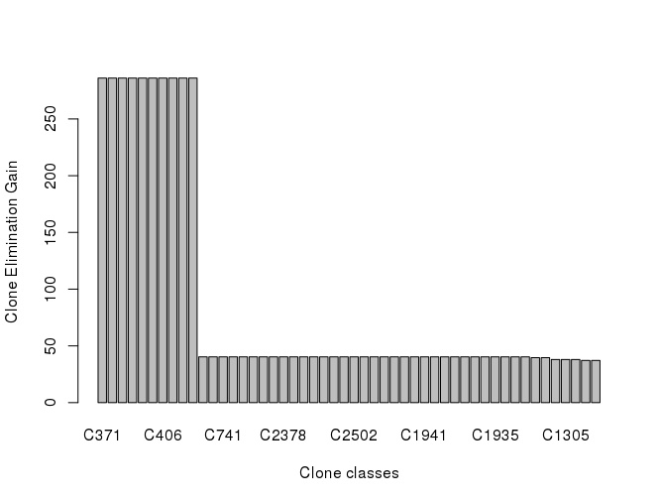
Bar plot : Clone_class vs CEG
unsorted
sorted by CEG, top 50

Slide 10

Conclusion

Slide 11
References
https://www.sourcemeter.com/resources/rpg/
http://citeseerx.ist.psu.edu/viewdoc/download?doi=10.1.1.59.2557&rep=rep1&type=pdf
https://www.cs.usask.ca/~croy/papers/2014/RoyetalCSMR-WCRE2014Keynote.pdf
http://www.ijcse.com/docs/INDJCSE11-02-05-149.pdf

Slide 12
